Slide 1
Path Finding
Data Structures & Algorithms

Slide 2
Shortest Path Problem
Find the shortest path between two nodes.
Disjjkstra’s algorithm provides a solution based on the adjacency matrix.
Infact the algorthim calculates the shortest path from one node to all the other nodes within the graph.

Slide 3
Graphical Representation of Algorithm
We can represent the execution of the algorithm graphically.
Using colour to highlight the nodes that have been visited
By attaching labels to the nodes that indicate the cumulative cost of reaching them from the origin node.

Slide 4
Notation
Unvisited node
Current node
Visited node
Distance to node from origin
2

Slide 5
Sequence
Set all nodes to unvisited and all distances to nodes as null.
Set the origin node to the current node and the distance to this node as zero.
Update the distances for all the nodes adjacent to the current node current node distance + the value of the edge.
Set the lowest distance adjacent node to current.
Continue to repeat steps 3 & 4. Over writing any distances which are higher.

Slide 6
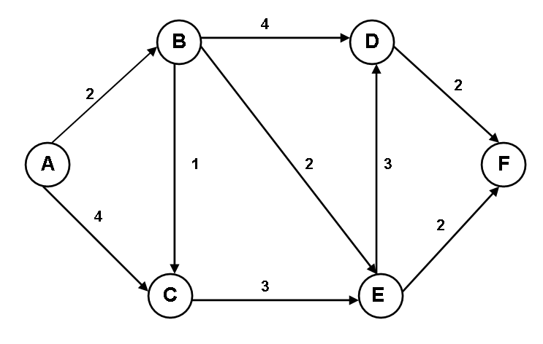
Example
Task – Find the shortest distance between Nodes A and F

Slide 7
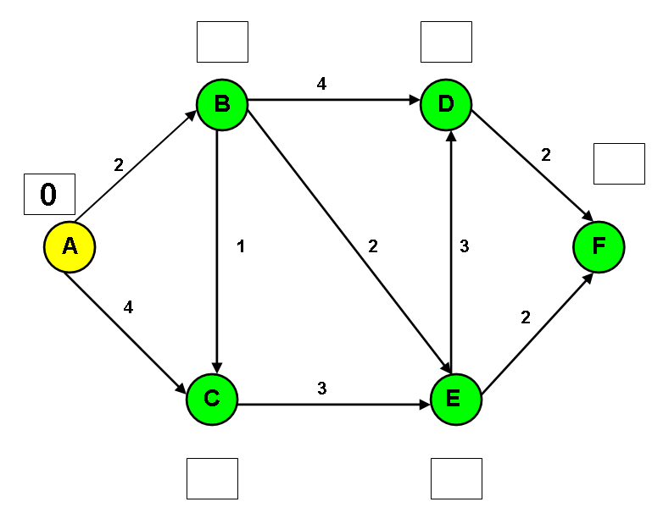
Step 1
Set the origin to the current node. Set all labels to null apart from the origin’s label which is zero.

Slide 8
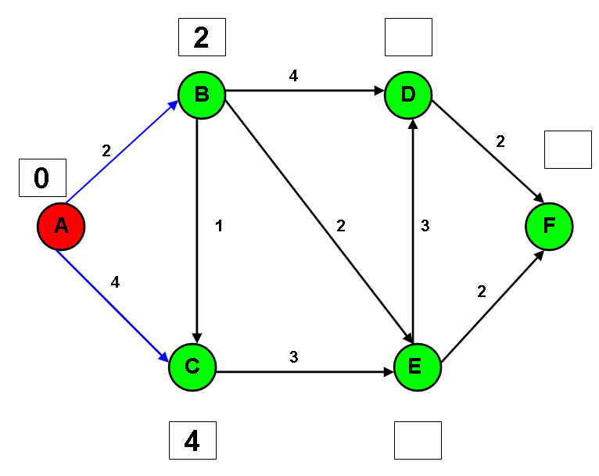
Step 2
Set adjacent nodes label’s to Current node label + edge value and set the current node to visited.

Slide 9
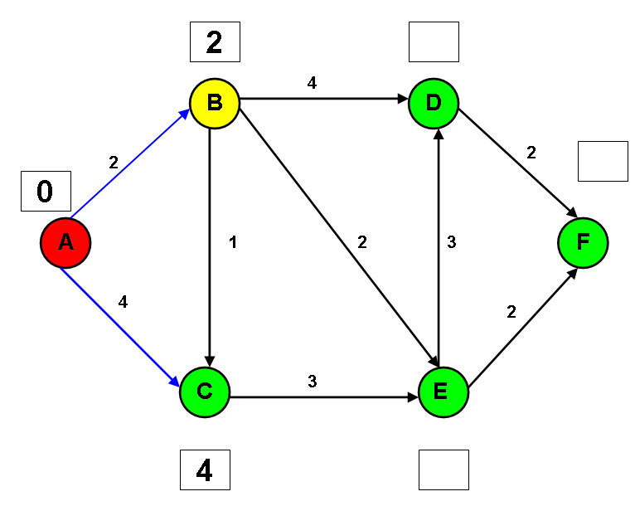
Step 3
Set the adjacent node with the lowest label to the current node.

Slide 10
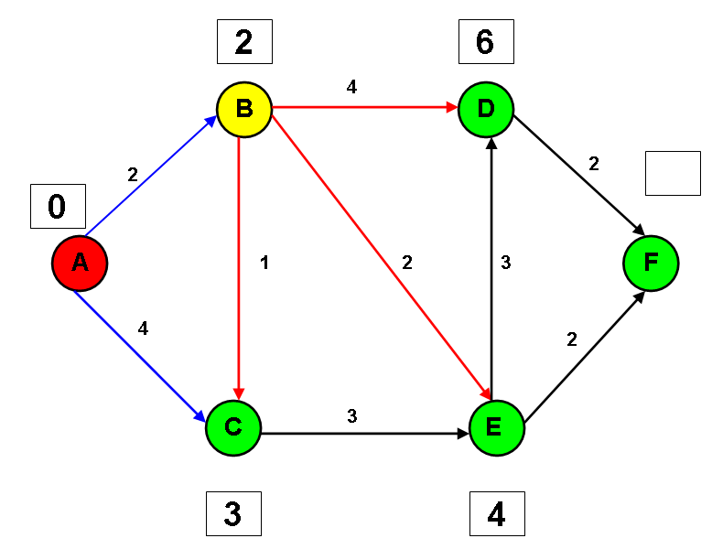
Step 4
Set adjacent nodes labels to Current node label + edge value. Note C’s label is reduced to 3.

Slide 11
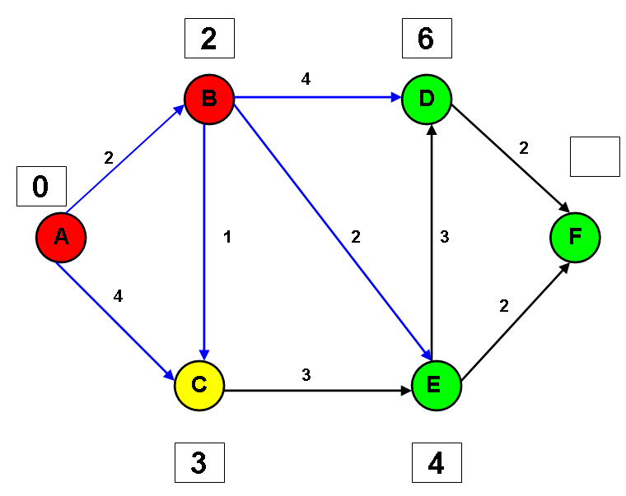
Step 5
Set B to visited and the adjacent node with the lowest label to the current node.

Slide 12
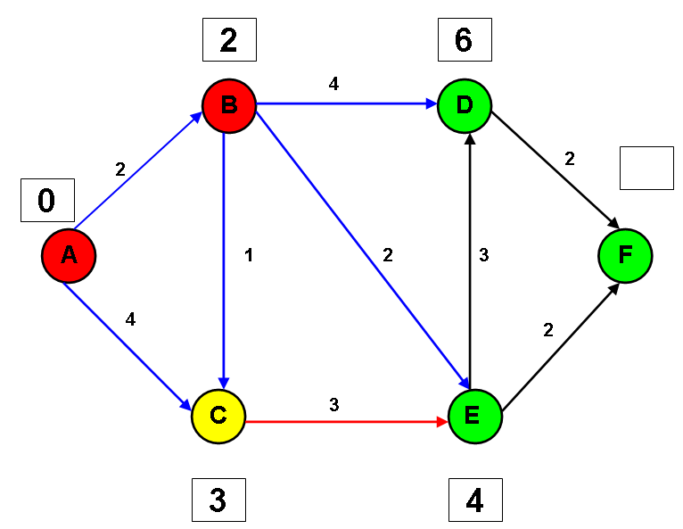
Step 6
Set adjacent nodes labels to Current node label + edge value. Note 6 is greater the E’s 4 so there is no change.

Slide 13
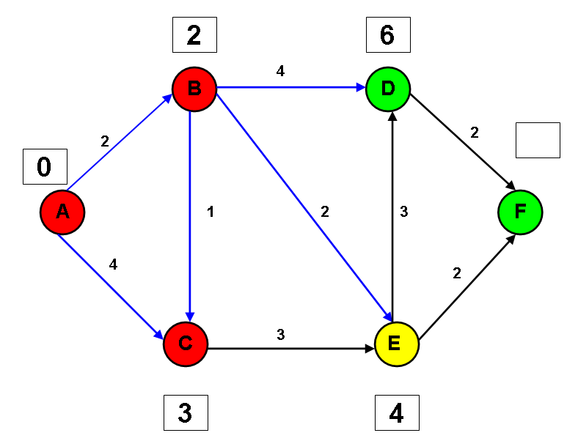
Step 7
Set C to visited and the adjacent node with the lowest label to the current node.

Slide 14
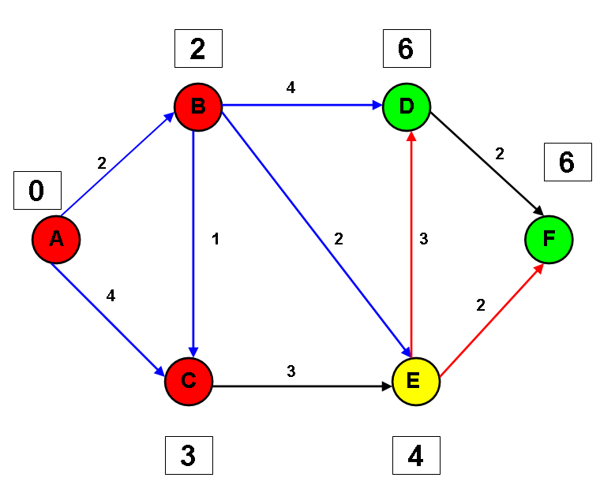
Step 8
Set adjacent nodes labels to Current node label + edge value. Note 7 is greater the D’s 6 so there is no change.

Slide 15
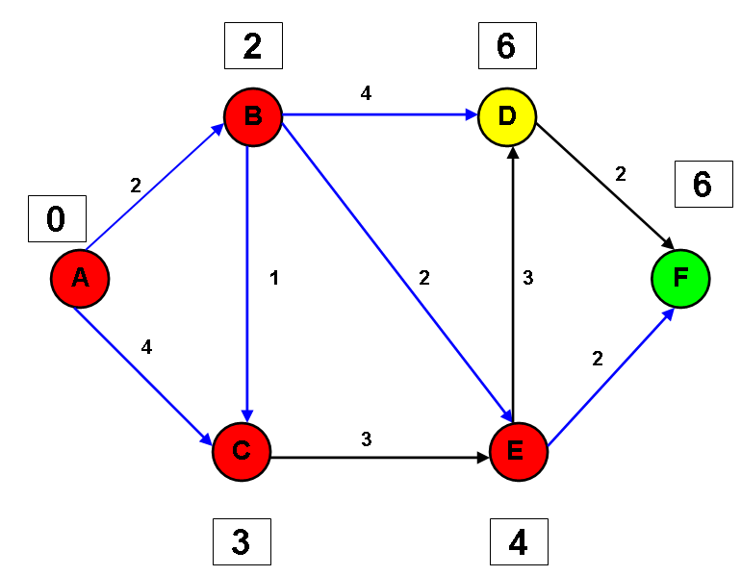
Step 9
Set E to visited and the adjacent node with the lowest label to the current node.

Slide 16
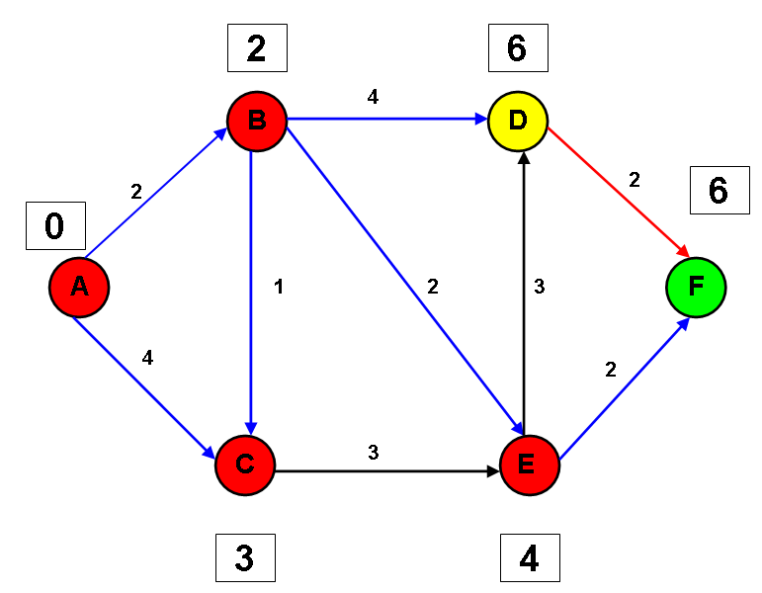
Step 10
Set adjacent nodes labels to Current node label + edge value. Note 8 is greater the F’s 6 so there is no change.

Slide 17
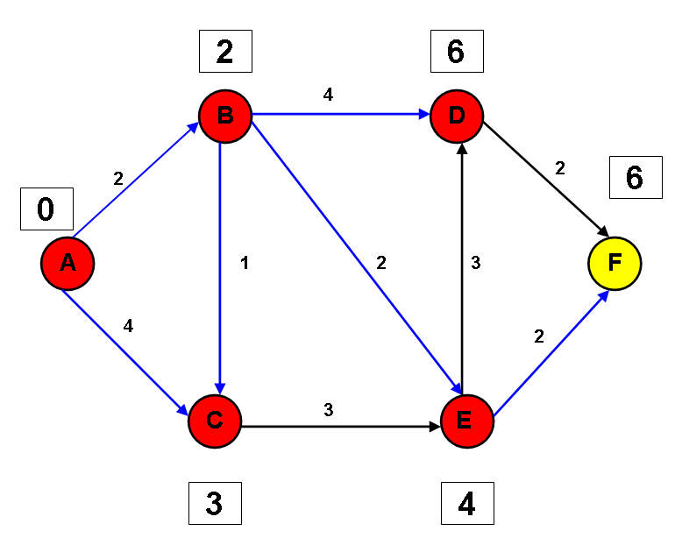
Step 11
Set D to visited and the adjacent node with the lowest label to the current node.

Slide 18
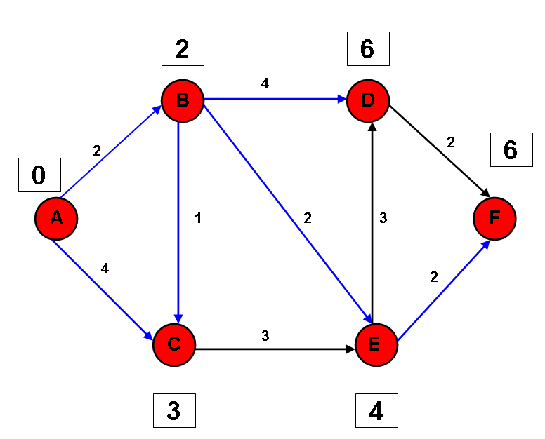
Step 12
Set F to visited. The exercise is complete. The shortest distance between A and F is 6.

Slide 19
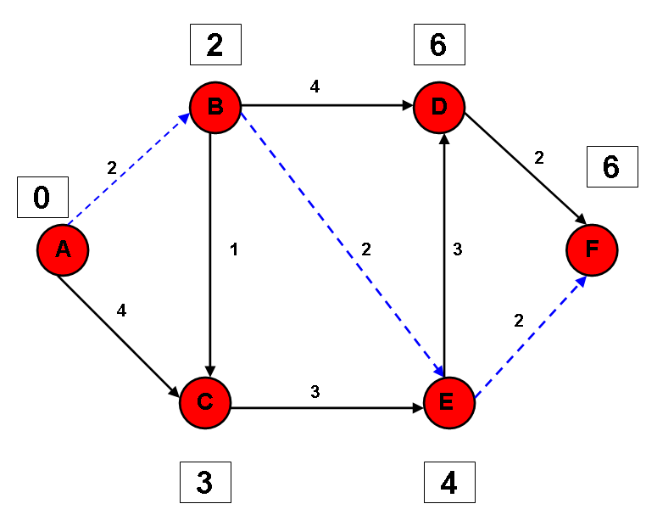
Shortest Path
You can trace the shortest path between A & F by backtracking from F to A, taking the shortest label route.

Slide 20
Dijkstra Algorithm
wrap start and goal in Nodes
insert start node into open list
Loop while open not empty
set current to lowest node in open
remove current from open
store current’s adjacent vertices in adjacent linked list
loop while adjacent not empty
set adj to lowest weighted in adjacent list
wrap adj in Node
set distance to current’s g value + DistanceBetween current and adj
if adj node’s g is zero or distance < adj node’s g
set adj node’s g to distance
set adj node’s parent to current
end if
if adj is goal
return ReconstructPlan(adj’s node)
end if
insert adj’s node into open
delete adj from adjacent list
end loop
end loop
return 0

Slide 21
Activity
Attempt Exercise 1 to 4, implementing Dijkstra’s algorithm

Slide 22
Introduction
The following slides provide a graphical representation of how the A* Algorithm works.
The example demonstrates how to find the least cost path from our current position to a Goal.
Cells represent Node within an environment.
Nodes are assigned a unique consequitive id.
Red cells are un navigable.

Slide 23
1 | 2 | 3 | 4 | 5 | 6
7 | 8 | 9 | 10 | 11 | 12
13 | 14 | 15 | 16 | 17 | 18
19 | 20 | 21 | 22 | 23 | 24
25 | 26 | 27 | 28 | 29 | 30
31 | 32 | 33 | 34 | 35 | 36
37 | 38 | 39 | 40 | 41 | 42
Start
Goal

Slide 24
Components
Node Data
H : Heuristic. Distance from Node to target Node.
G : Movement Cost
F : H + G
Parent : Node by which to reach this Node
Lists
Open List : Nodes that Require Checking
Closed List : Nodes from the Open List that have been checked

Slide 25
Heuristic
Definition : “a trial-and-error method of problem solving used when an algorithmic approach is impractical”.
The heuristic algorithm is dependent on the application. Remember GOAP used the mismatching Atoms in the World State. A navigational system may use the distance between way points – ignoring obstacles.
For our example the cell’s heuristic value is the distance in cells from it to the goal. Treating all cells as navigable.

Slide 26
Calculating H (Heuristic)
1 | 2 | 3 | 4 | 5 | 6
7 | 8 7 | 9 | 10 | 11 | 12
13 | 14 | 15 | 16 | 17 | 18
19 | 20 | 21 | 22 | 23 | 24
25 5 | 26 | 27 | 28 | 29 | 30
31 | 32 | 33 | 34 | 35 | 36
37 | 38 | 39 | 40 | 41 | 42
Start
Goal

Slide 27
H (Heuristic) Values
1 9 | 2 8 | 3 7 | 4 6 | 5 5 | 6 6
7 8 | 8 7 | 9 6 | 10 5 | 11 4 | 12 5
13 7 | 14 6 | 15 5 | 16 | 17 3 | 18 4
19 6 | 20 5 | 21 4 | 22 3 | 23 2 | 24 3
25 5 | 26 | 27 3 | 28 | 29 1 | 30 2
31 4 | 32 3 | 33 2 | 34 | 35 | 36 1
37 5 | 38 4 | 39 3 | 40 2 | 41 1 | 42 2
Start
Goal

Slide 28
Movement Cost
The G value
Application dependent.
In the example
Horizontal or vertical movement will have a cost of 10
Diagonal movement will have a cost of 14. sqrt(10*10 + 10*10)

Slide 29
G (Movement Cost) Values
1 9 | 2 8 | 3 7 | 4 6 | 5 5 | 6 6
7 8 | 8 7 | 9 6 | 10 5 | 11 4 | 12 5
13 7 | 14 6 | 15 5 | 16 | 17 3 | 18 4
19 6 | 20 5 | 21 4 | 22 3 | 23 2 | 24 3
25 5 | 26 | 27 3 | 28 | 29 1 | 30 2
31 4 | 32 3 | 33 2 | 34 | 35 | 36 1
37 5 | 38 4 | 39 3 | 40 2 | 41 1 | 42 2
10
14
Start
Goal

Slide 30
Parents
Each Node has a single parent
The parent indicates the least cost path to that Node.
On the slides each Node will be assigned an orange arrow indicating the parent of that Node.

Slide 31
Search Step 1
1 9 | 2 8 | 3 7 | 4 6 | 5 5 | 6 6
7 8 | 8 7 | 9 6 | 10 5 | 11 4 | 12 5
13 7 | 14 6 | 15 5 | 16 | 17 3 | 18 4
19 6 | 20 5 | 21 4 | 22 3 | 23 2 | 24 3
25 5 | 26 | 27 3 | 28 | 29 1 | 30 2
31 4 | 32 3 | 33 2 | 34 | 35 | 36 1
37 5 | 38 4 | 39 3 | 40 2 | 41 1 | 42 2
Open List
7,8,9,13,15,19,20,21
Closed List
14
Start
Goal

Slide 32
Search Step 2
1 9 | 2 8 | 3 7 | 4 6 | 5 5 | 6 6
7 14 8 22 | 8 10 7 17 | 9 14 6 20 | 10 5 | 11 4 | 12 5
13 10 7 17 | 14 6 | 15 10 5 15 | 16 | 17 3 | 18 4
19 14 6 20 | 20 10 5 15 | 21 14 4 18 | 22 3 | 23 2 | 24 3
25 5 | 26 | 27 3 | 28 | 29 1 | 30 2
31 4 | 32 3 | 33 2 | 34 | 35 | 36 1
37 5 | 38 4 | 39 3 | 40 2 | 41 1 | 42 2
Open List
7,8,9,13,15,19,20,21
Closed List
14
Start
Goal

Slide 33
Search Step 3
1 9 | 2 8 | 3 7 | 4 6 | 5 5 | 6 6
7 14 8 22 | 8 10 7 17 | 9 14 6 20 | 10 24 5 29 | 11 4 | 12 5
13 10 7 17 | 14 6 | 15 10 5 15 | 16 | 17 3 | 18 4
19 14 6 20 | 20 10 5 15 | 21 14 4 18 | 22 24 3 27 | 23 2 | 24 3
25 5 | 26 | 27 3 | 28 | 29 1 | 30 2
31 4 | 32 3 | 33 2 | 34 | 35 | 36 1
37 5 | 38 4 | 39 3 | 40 2 | 41 1 | 42 2
Open List
7,8,9,13,19,20,2,10,22
Closed List
14,15
Start
Goal

Slide 34
Search Step 4
1 9 | 2 8 | 3 7 | 4 6 | 5 5 | 6 6
7 14 8 22 | 8 10 7 17 | 9 14 6 20 | 10 24 5 29 | 11 4 | 12 5
13 10 7 17 | 14 6 | 15 10 5 15 | 16 | 17 3 | 18 4
19 14 6 20 | 20 10 5 15 | 21 14 4 18 | 22 24 3 27 | 23 2 | 24 3
25 24 5 29 | 26 | 27 24 3 27 | 28 | 29 1 | 30 2
31 4 | 32 3 | 33 2 | 34 | 35 | 36 1
37 5 | 38 4 | 39 3 | 40 2 | 41 1 | 42 2
Open List
7,8,9,13,19,20,21,10,22,25,27
Closed List
14,15,20
Start
Goal

Slide 35
Search Step 5
1 24 9 33 | 2 20 8 28 | 3 24 7 31 | 4 6 | 5 5 | 6 6
7 14 8 22 | 8 10 7 17 | 9 14 6 20 | 10 24 5 29 | 11 4 | 12 5
13 10 7 17 | 14 6 | 15 10 5 15 | 16 | 17 3 | 18 4
19 14 6 20 | 20 10 5 15 | 21 14 4 18 | 22 24 3 27 | 23 2 | 24 3
25 24 5 29 | 26 | 27 24 3 27 | 28 | 29 1 | 30 2
31 4 | 32 3 | 33 2 | 34 | 35 | 36 1
37 5 | 38 4 | 39 3 | 40 2 | 41 1 | 42 2
Open List
7,9,13,19,20,21,10,22,25,27
Closed List
14,15,20,8
Start
Goal

Slide 36
Completed Search
1 24 9 | 2 20 8 | 3 24 7 | 4 28 6 | 5 38 5 43 | 6 48 6 54
7 14 8 | 8 10 7 | 9 14 6 | 10 24 5 | 11 34 4 | 12 44 5 49
13 10 7 | 14 6 | 15 10 5 | 16 | 17 38 3 | 18 48 4 52
19 14 6 | 20 10 5 | 21 14 4 | 22 24 3 | 23 34 2 | 24 44 3 47
25 24 5 | 26 | 27 24 3 | 28 | 29 38 1 | 30 48 2 50
31 34 4 | 32 38 3 41 | 33 34 2 | 34 | 35 | 36 1
37 44 5 49 | 38 48 4 52 | 39 44 3 47 | 40 48 2 50 | 41 1 | 42 2
Open List
5,17,29,32,18,24,30,38,39,40,6,12,37
Closed List
14,15,20,8,13,21,9,19,7,27,2,10,25,22,3,1,4,23,33,31,29
Start
Goal

Slide 37
The Path
1 24 9 | 2 20 8 | 3 24 7 | 4 28 6 | 5 38 5 43 | 6 48 6 54
7 14 8 | 8 10 7 | 9 14 6 | 10 24 5 | 11 34 4 | 12 44 5 49
13 10 7 | 14 6 | 15 10 5 | 16 | 17 38 3 | 18 48 4 52
19 14 6 | 20 10 5 | 21 14 4 | 22 24 3 | 23 34 2 | 24 44 3 47
25 24 5 | 26 | 27 24 3 | 28 | 29 38 1 | 30 48 2 50
31 34 4 | 32 38 3 41 | 33 34 2 | 34 | 35 | 36 1
37 44 5 49 | 38 48 4 52 | 39 44 3 47 | 40 48 2 50 | 41 1 | 42 2
Tracing back from the Goal following the parents

Slide 38
A* Algorithm
wrap start and goal in Nodes
insert start node into open list
Loop while open not empty
set current to lowest node in open
remove current from open
store current’s adjacent vertices in adjacent priority list
loop while adjacent not empty
set adj to the remove vertex in adjacent priority list
wrap adj in Node
set adjNode’s parent to current
if adjNode is goal
return ReconstructPlan(adj’s node)
end if
adjNode’s g = current’s g + DistanceBwteenvertices current and adj
adjNode’s h = GetHeuristic between adj and goal
adjNode’s f = g + h
set foundInOpen = find adj’s node in open list
if foundInOpen <> 0 and foundInOpen’s f < adj Node’s f
skip to next adjacent iteration
end if
set foundInClosed = find adj’s node in closed lis
if foundInClose <> 0 and foundInClosed’s f < adj Node’s f
skip to next adjacent iteration
end if
insert adj node into open
end loop
insert current into closed
end loop
return 0

Slide 39
Activity
Attempt Exercise 5 to 8, implementing the A* star algorithm

